Slide 1
Detractors’ profiling
Second deliverable

Slide 2
Executive Summary
With convergent customers in mind, advances have been made in profiling detractors
These advances have been driven by the usage of port-out requests as a hard detractor proxy:
Due to the scarce number of NPS surveys, a proxy is needed to have a wider perspective and behaviour understanding
Main advantages of this proxy are:
Inherit triggers, insights and capabilities from port-out requests model which actually led to more than 16M€ incremental CLTV in November 2017
Take benefit from a solid model with more than 12 months of life
Data Sources:
Complete analysis of call centre interactions, quality of fixed network, quality of mobile network, data consumption, sociodemographic and behavioural data
Call to action:
Definition of an actionable campaign for 200k VF Convergent & Ono customers

Slide 3
Hard Detractors actionable insights (VF Convergent base)
The following actions and conclusions apply to VF convergent customers
Definition of a target group of 100k customers with highest scores according to the model
This group is defined mostly under the following criteria:
They have no pending payments, in contrast to 5.52 pending payments on average fn the rest
They are 41.8 years old on average (3.6 years younger than the rest)
They have no commitment, in contrast with 4 months of pending commitment on average fn the rest
Their service has a tenure of 10 months on average, in contrast with 4.5 years on average of the rest
Their ARPU is 15% less than the rest
They pay for SMS in contrast to other customers having costless SMS tariffs
Notice that target volume has been obtained based on port-out request model score, which “summarises”/covers wider and more richer business rules

Slide 4
Hard Detractors actionable insights (Ono base)
The following actions and conclusions apply to Ono customers
Definition of a target group of 100k customers with highest scores according to the model
This group is defined mostly under the following criteria:
They have 1.8 years on average of tenure in their latest fixed line, in contrast with 6.2 years of the rest
They have 0.85 years on average of tenure in their TV service, in contrast with 1.8 years of the rest
Their average number of calls is 30% less
Their average number of days with data usage is 50% less
Notice that target volume has been obtained based on port-out request model score, which “summarises”/covers wider and more richer business rules

Slide 5
Hard Detractors actionable insights
Main reasons why these users (VF convergent & Ono) are hard detractors
Interactions:
They have 2.2x more interactions for billing issues
They have 1.5x more interactions for technical problems
They have 1.4x more interactions with escalated technical problems
Quality of Fixed Network:
They have 1.2x more speed degradation issues

Slide 6
Hard Detractors actionable insights
We suggest to take an action on these 200k users taking care of their billing issues and ADSL/Fibre user experience.
The accuracy of our port-out request models are around 70%, which led an incremental CLTV of 16M€ in November 2017.
The usage of port-out request as a proxy may have impact on the churn model itself, which we are currently analysing in detail.
Reader may find useful the additional content attached in this document:
The methodology used to validate port-out request proxy
The usage of this proxy is part of a wider roadmap that can be seen under slide 8 (Roadmap and Next Steps)
Summary of all the main work carried out by Big Data under the track of Detractor Profiling since October 2017

Slide 7
Additional content

Slide 8
Methodology: Problem Statement
Customer surveys represent a small portion of the customer base (less than 1%)
Therefore a proxy is needed so that detraction can be deeply understood
Port-out request (or churn propensity) may seem the most promising proxy for detraction
The benefits from considering this proxy are significant (mainly triggers definition and actionability)
NPS estimation
Proxy**
Disadvantages
Care when selecting the proxy
Advantages
Inherit conclusions from proxy
Experience in using triggers
Actionable
With small portion of data, proxy may be chosen
Model
Disadvantages
Non representative data
Partial customer view
Advantages
Ad-hoc model creation
Understand specific behaviors
* Advantages and disadvantages of using a proxy in comparison to a model when estimating NPS
** Proxy may lead also to a predictive model although as an indirect result

Slide 9
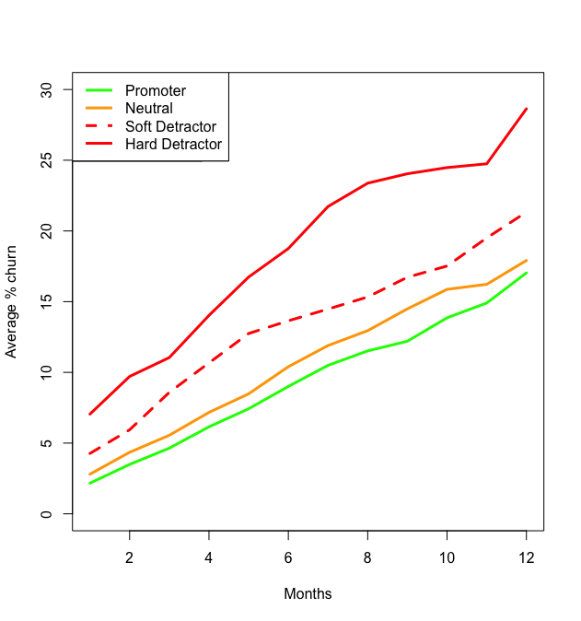
Methodology: Validate proxy hypothesis
Why port-outs requests?
Port-outs requests provide a better understanding of customer churn attempts
This metric avoids the retention effect
In fact, port-outs requests is the metric used in Big Data Group
Validation is given by the fact that:
Hard Detractors show a 1.5x faster Port-out requests percentage month over month
Promoters and Neutral present similar rates
Conclusion
Port-outs requests is a valid proxy for hard detractors
Average % port-out request
Months since customer survey

Slide 10
Roadmap and next steps
Estimate thresholds for port-out requests score and segment
Inherit triggers and actionable insights from port-out requests
Validate port-out requests as a proxy for NPS estimation
Find a suitable proxy from Big Data models
Roadmap for this scope
Validate proxy hypothesis
Is port-out request a valid proxy for NPS Estimation?
If so, to what extent?
How can the proxy bring insights to NPS understanding?
Actions proposed after data analysis
Next steps and global roadmap
Given the proxy, which thresholds/boundaries correspond to every NPS value?
Estimate thresholds per segment and stack (until both stacks apply)
Enrich more sources of fixed data usage and quality

Slide 11
Previous meetings and deliverables
October 4th
Descriptive analysis of detractors/neutrals/promoters from customer base
Study of main variables and attributes that lead to detraction
Live case study on understanding relationship between CEM and Detraction
Action plan: Consolidate this information into an actionable campaign
October 20th
Deep-dive analysis on new data sources such as interactions and net quality of service
Live case study on how these former variables affect NPS
NPS estimation model for ONO customers that lead to an actionable campaign
Action plan: Launch the actionable campaign and consolidate results from BDP data
October 31st
Deliverable with more than 200+ variables and their relationship to NPS Estimation
List of detractor candidates with at least some interactions associated to unsolved technical problems in the call centre

